Slide 1
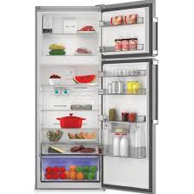
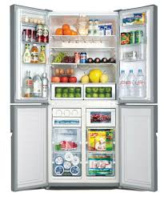

Detecting fridge staff
Group Members
Utku Fışkın
Burak Giritlioğlu
Selin Sezer
Supervised by
Aytül Erçil
Fall 2017-2018
Sabancı University

Slide 2

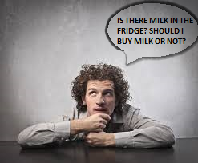
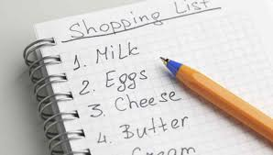
Starting point
In daily life, people prepare shopping lists before they go shopping or people might encounter with some problems, for example, they might forget to buy some staffs. The beginning point of our aim is getting rid of all of these options.

Slide 3
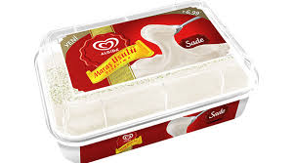
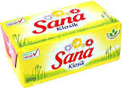
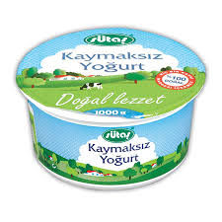


objective
With our project, all staffs in
fridge could be detected, there are
no sharp limitations about staff
variety, and users
will be able to be informed about
the absence or existence
of
these staffs via e-mail.

Slide 4
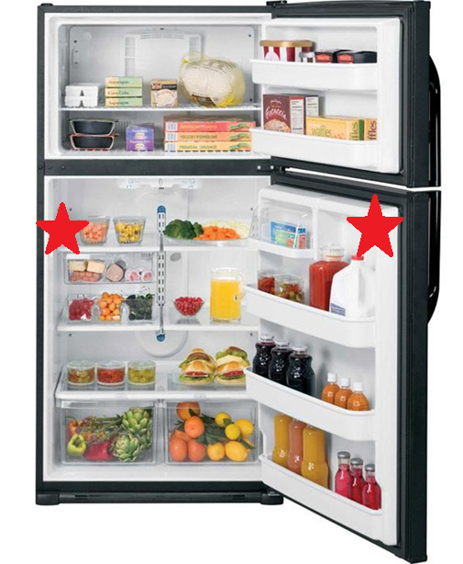
We start this project
with assumptions.
We assume that,
there are two
cameras. The left one
looks shelf and the
right one looks
inside of fridge.

Slide 5

ALGORITHM
Flow Chart
Explanation of all steps in our algorithm
Our Achievements
Explanation of obtained consequences with process of algorithm
This project is designed in Matlab.

Slide 6
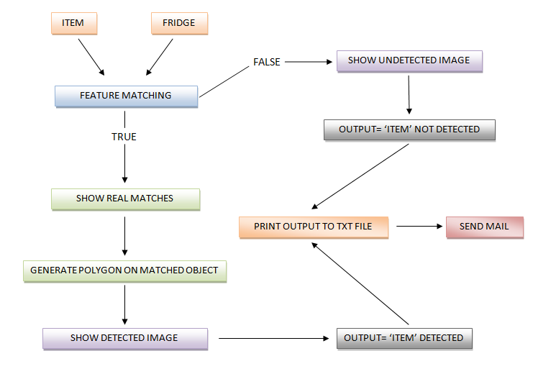
Flow chart

Slide 7
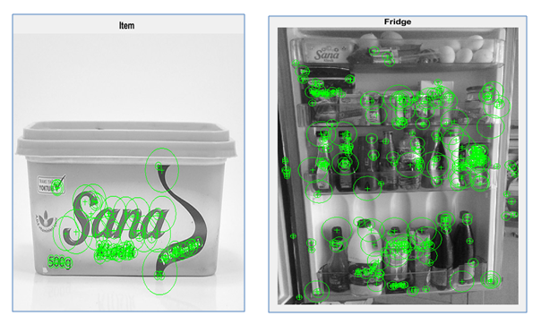
our achievements
There are a lot of kinds of functions for feature matching and we chose ‘detectSURFFeatures’ function.
100 strongest points of ItemPoints 300 strongest points of FridgePoints
‘selectStrongest ‘ function

Slide 8
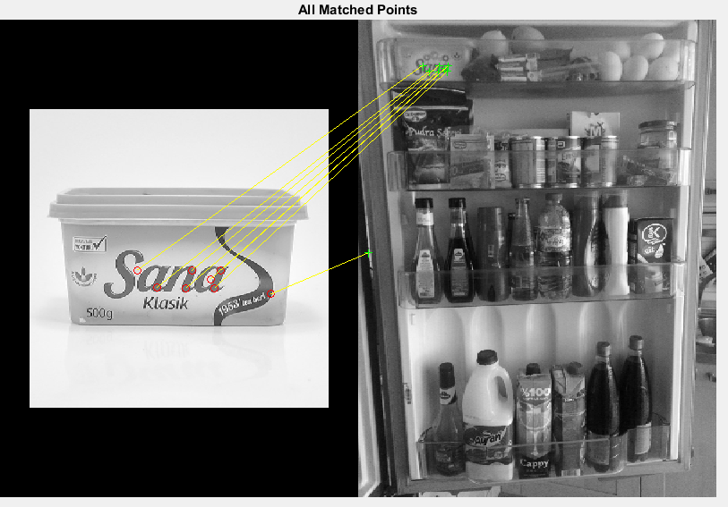
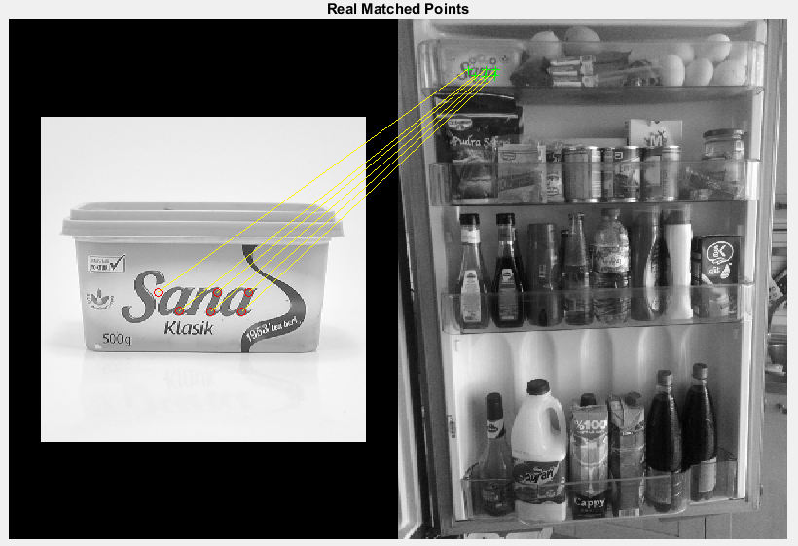
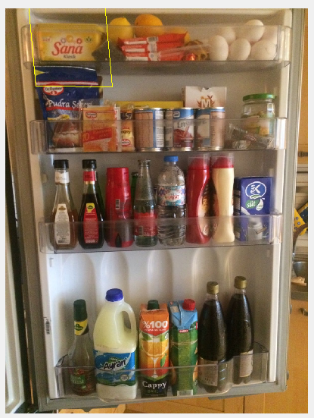
Lines for all matched points ’showMatchedFeatures’
Lines for the most relating matched points ’estimateGeometricTransform’
Eliminate the lines which stay outside
‘Affine’ options
Polygon on our matched object

Slide 9
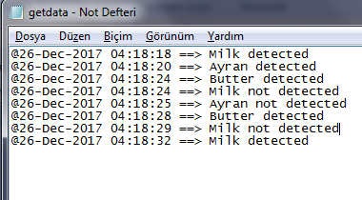
We defined fileID as getdata.txt and as we stated in the
detectfridge function explanation, if value is 1, it means ‘ Item
detected’, else it means ‘ Item not detected’ as you can see from
the image above. Then, we determined the time and printed
the output with ‘fprint’ function to our txt file.

Slide 10
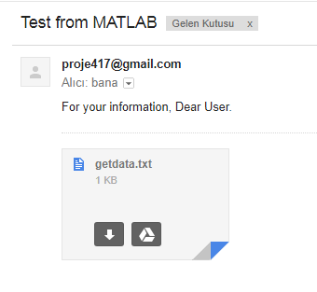
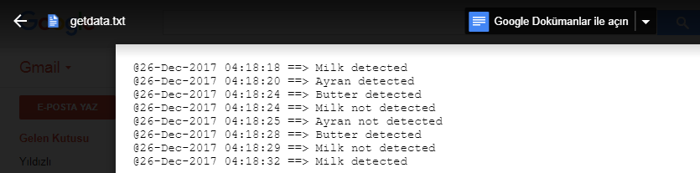
1) define mail1 which send mail, mail2 which get mail, and password. 2) identify and register SMTP server, we used gmail smpt ID. 3) make our mail address which send e-mail enable to use. 4) define props from java.lang.System and with respectively we make authentication true and then we set its socket and also its port number. 5) print the results on a text file in our main code and with sendmail function, we are able to send this text file via our mail.

Slide 11
PROSPECTIVE DEVELOPMENTS
With Raspberry Pi, its camera and light sensor, this project could evolve.
The combination of these additions and our software system, we could put this project into practice and it will be ready to launch to the market.
In addition, this product could use in the markets to detect existence or absence of staffs and print the number of those staffs in future.

Slide 12
AND THE SHOPPING LIST BECOME HISTORY…

Slide 13
REFERENCE
https://www.mathworks.com/help/vision/examples/object-detection-in-a-cluttered-scene-using-point-feature-matching.html
https://www.mathworks.com/help/matlab/ref/sendmail.html
https://www.mathworks.com/help/matlab/ref/fprintf.html

